Slide 1
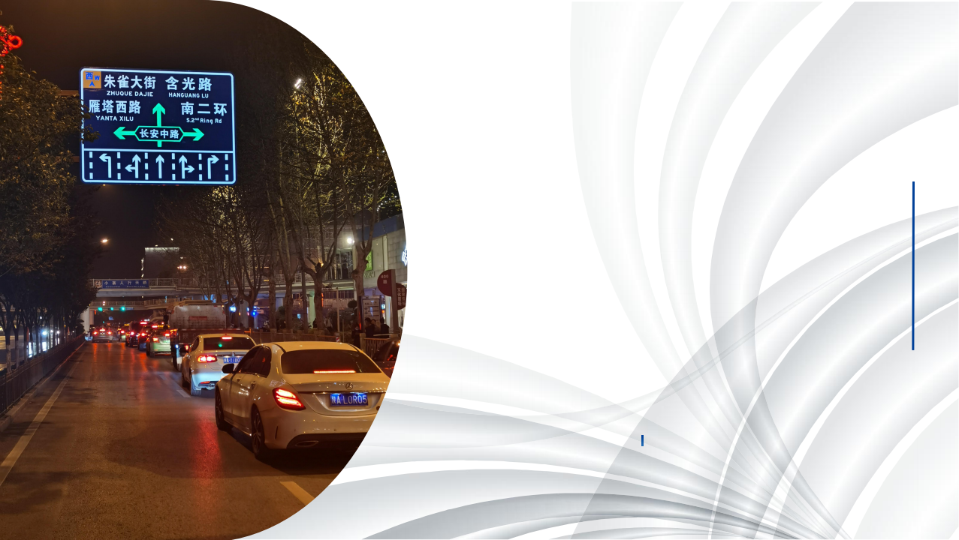
Self illuminated traffic signs
Typical application

Slide 2
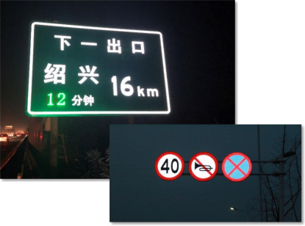
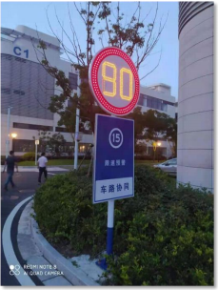
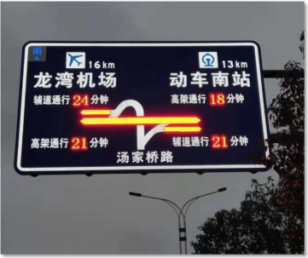
PAGE 1
—— Full transparent, semi-transparent, dot matrix, network type full series, multi-scene, multi-purpose luminous sign, give full consideration of technology-economy,
Cost-benefit, facing the characteristics and needs of urban roads, roads and rural roads.
Semi-transparent and full transparent self illuminated sign
Dot-matrix self illuminated sign
Intelligent network self illuminated sign

Slide 3
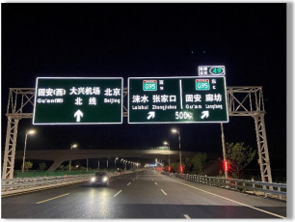
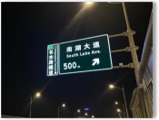
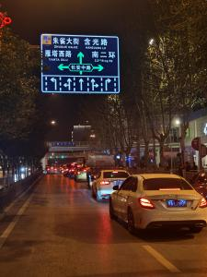
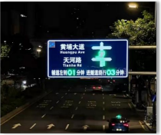
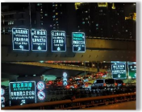
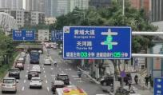
PAGE 2
It has been demonstrated in more than 30 expressways in 106 cities in 28 provinces (autonomous regions and municipalities directly under the Central Government)
Jiaxing Expressway
Supporting transportation projects of Xiongan New Area —— Beijing-Xiong, Jingde and Rongwu expressways
Shanghai North Cross Channel
Xi'an Xiaozhai Cross
Hunde Avenue, Guangzhou

Slide 4
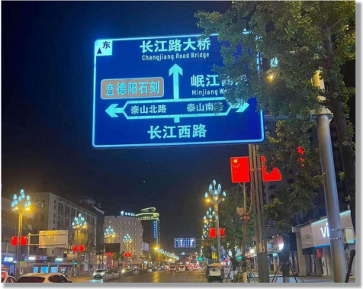
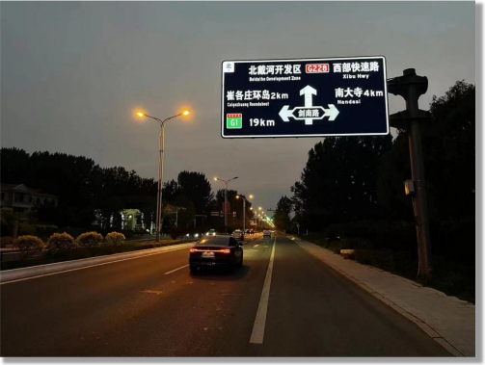
PAGE 3
City road scene
Deyang · Jingyang District
Qinhuangdao · Beidaihe District
Semi-permeable sign and urban lighting project complement each other
The significant visual effect of semi-transparent signs in the evening

Slide 5
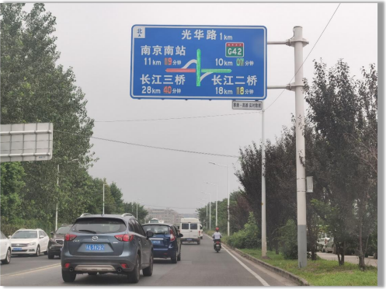
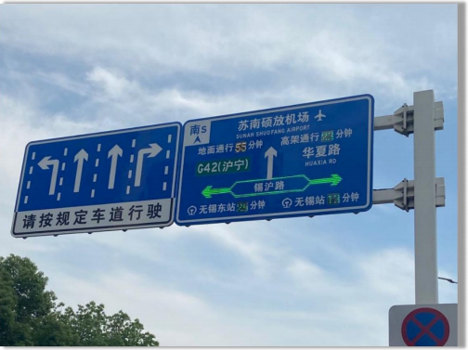
PAGE 4
City road scene
Nanjing · Baixia Park
Wuxi · Smart Transportation Project
Netted sign for multipath induction of key nodes
The connected sign realizes continuity induction in important sections

Slide 6
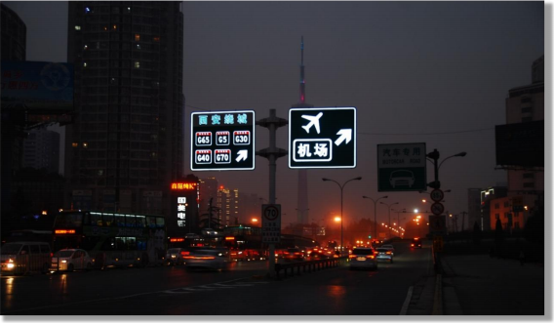
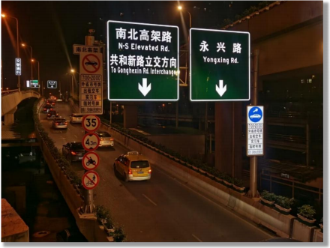
PAGE 5
Urban expressway scene
Xi'an · Ring City Expressway
Shanghai · North heng Channel
The active luminous sign is in sharp contrast to the ordinary sign
Near and far combination, fast selection of the passage path

Slide 7
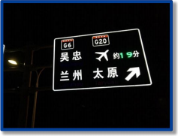
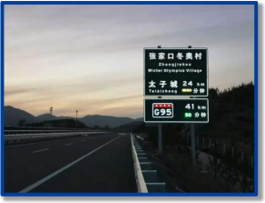
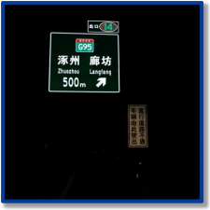
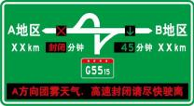
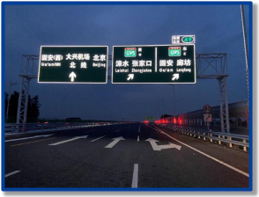
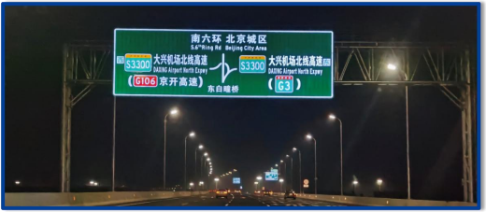
PAGE 6
Highway scene
Ningxia · Wisdom High-speed
Hebei · Yanchong Expressway
Beijing-Germany high-speed
The Hebei section of the Beijing-Xiong Expressway
S3501 Beijing Daxing Airport Expressway Project

Slide 8
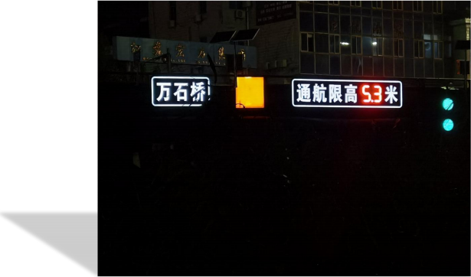
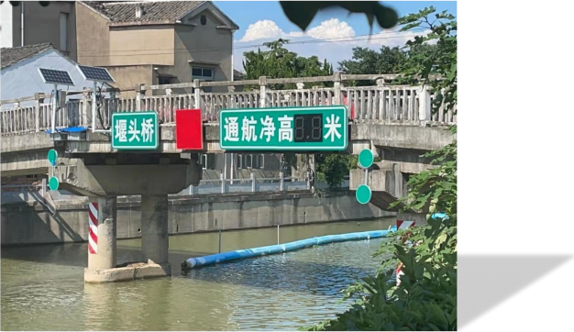
PAGE 7
Water channel scene
channel signs

Slide 9
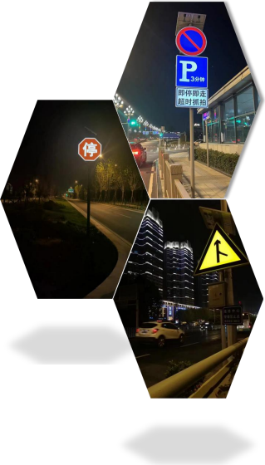
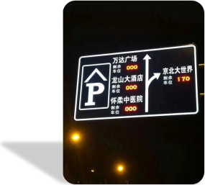
PAGE 9
Other application scenarios
On the road section outside the grid laying range, solar energy
The power supply mode can still play the full effect of the self illuminated sign.
Guide the location of the parking lot for the drivers,
It is also a classic application of active luminous sign to inform the remaining number of each parking lot in advance

Slide 10
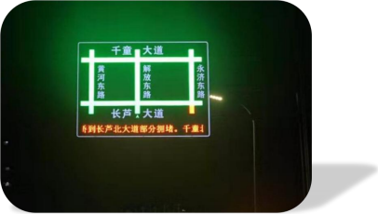
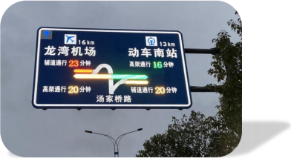
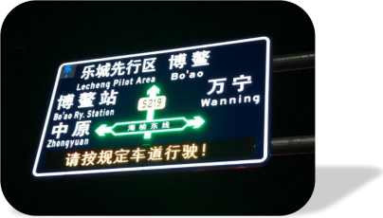
PAGE 10
①
Other application scenarios
②
The application of the luminous sign can not only be full
Foot drivers' demand for route guidance,
It can also help managers with road communication
Macro-control of the flow.
▲ Guiyang · Road network level traffic information release
③
① Road network level line induction, with the road name and road
Road congestion status is the main display information.
▲ Wenzhou · Release of traffic information on different paths
② Node-level path guidance, to the important far node travel
Time and road traffic status are the main display information
③ Intersection level line guide, to the node place names and below
The congestion status at a road intersection is the main display information
▲ Qionghai · Road intersection level traffic information release

